Slide 1

Traffic Signs Detection And Recognition
presentation

Slide 2
Members
Team members:
1) Mina Leon
2) Sayed Ashraf
3) Ghaly Mansour
4) Tariq Ziad
Supervisors:
Doc / Hala Musher
TA / Menna TullahMamdouh

Slide 3
Agenda
Introduction
Survey
Dataset
System Architecture 1
System Architecture 2
Conclusions
Tools
Demo

Slide 4
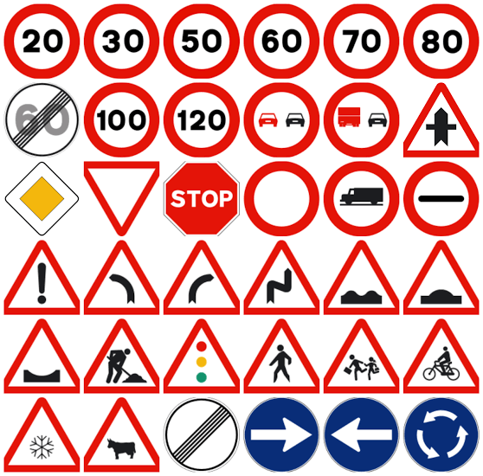

Introduction
Contemporary driving aid systems consist of many modules,
responsible for providing the driver with information.
One of the important parts of such a system is a module
designed for recognition of the trafﬁc signs passed by a car.

Slide 5

Motivation
Due to the increase in the population and the increase in the number of accidents because of the inefficient way that represents the traffic signs, so we will design an application software that detects traffic signs in images and show the meaning of each sign.

Slide 6
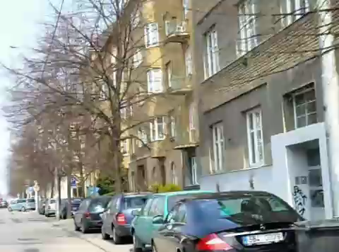
Problem Definition
The identiﬁcation is based on video camera image analysis.

Slide 7
Agenda
Introduction
Survey
Dataset
System Architecture 1
System Architecture 2
Conclusions
Tools
Demo

Slide 8
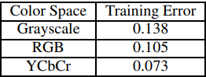
Traffic Signs Recognition and Classification based on Deep Feature Learning:
26 February 2018. Yan Lai. Nanxin Wang. Yusi Yang. Lan Lin.
Uses the YCbCr or CNN’s Feature Extraction.
Build a model from scratch to extract the features form the gray scale image and classify it.
Uses German Traffic Signs Recognition Benchmark (GTSRB) Data Set.
Final Accuracy: 98.6% Classification

Slide 9
Traffic-Sign Detection and Classification under Challenging Conditions: A Deep Neural Network Based Approach:
4 January 2019. Uday Kamal. Sowmitra Dasy. Abid Abrarz. Md. Kamrul Hasanx.
Uses pre-processing technique called the Contrast Limited Adaptive Histogram Equalization (CLAHE).
Uses VGG16 Pre-trained Model and some more layers to extract the features and classify images.
Uses IEEE VIP Cup 2017 Data Set.
Final Accuracy: 62% Detection

Slide 10
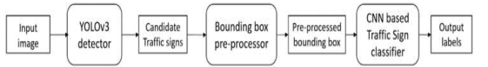
Real-Time Traffic Sign Recognition using YOLOv3 based Detector:
8 July 2019. Shehan P Rajendran. Linu Shine. Pradeep R. Sajith Vijayaraghavan.
Uses the YOLOv3 in the detection of the traffic sign in the original image.
Cut the boxes surrounding the image then, classify each box using the classifier model.
Uses German Traffic Sign Detection Benchmark (GTSDB) and German Traffic Sign Recognition Benchmark (GTSRB) Data Sets.
Final Accuracy: 99.59% Classification and 92.2% Detection

Slide 11
Papers Comparison
Paper | Accuracy | Data Set
Traffic Signs Recognition and Classification based on Deep Learning | 98.6% Classification | German Traffic Signs Recognition Benchmark (GTSRB)
Traffic-Sign Detection and Classification using Deep Neural Network Approach | 62% Detection and Classification over all | IEEE VIP Cup 2017
Real-Time Traffic Sign Recognition using YOLOv3 based Detector | 99.59% Classification And 92.2% Detection | German Traffic Sign Detection Benchmark (GTSDB) and German Traffic Sign Recognition Benchmark (GTSRB)

Slide 12
Agenda
Introduction
Survey
Dataset
System Architecture 1
System Architecture 2
Conclusions
Tools
Demo

Slide 13
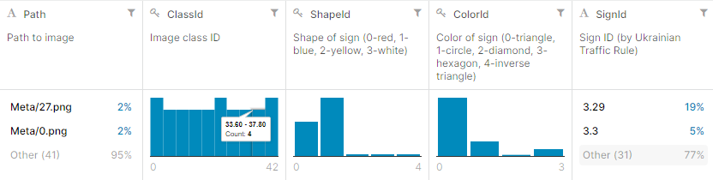
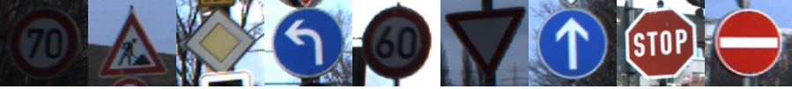
Dataset [GTSRB]
Classification part
Usage Of Data | Number Of Samples
Train | 34902 samples.
Validation | 4314 samples.
Testing | 12630 samples
Data Distribution

Slide 14
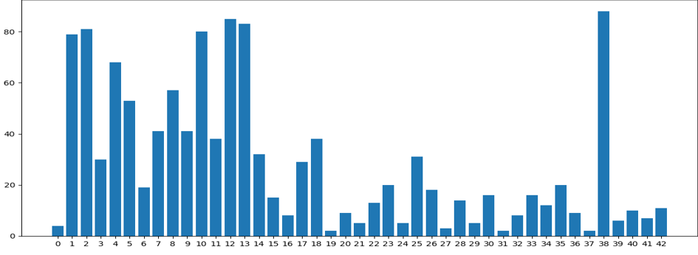
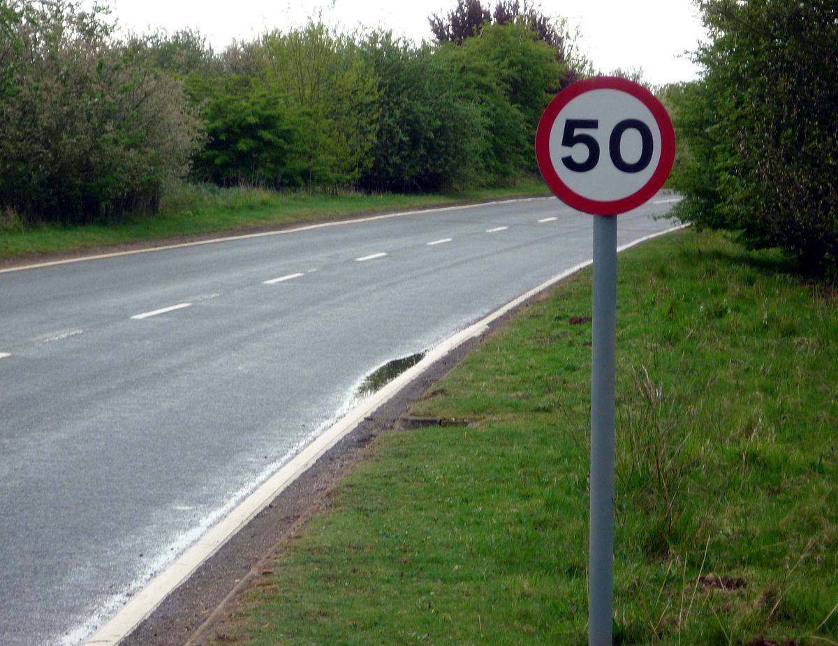
Dataset [GTSDB]
Detection part
Data Distribution
Usage Of Data | Number OF Samples
Train | 600 Samples
Validation | 300 Samples

Slide 15
Agenda
Introduction
Survey
Dataset
System Architecture 1
System Architecture 2
Conclusions
Tools
Demo

Slide 16

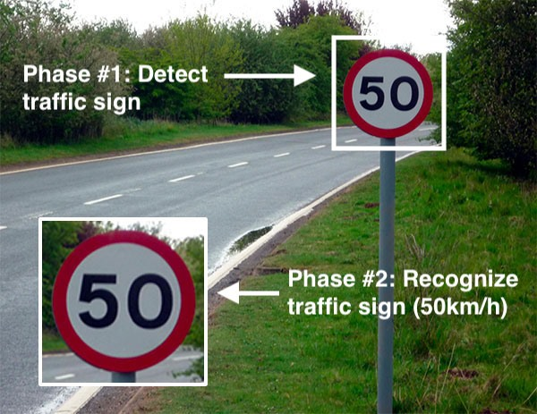
Our System Steps

Slide 17
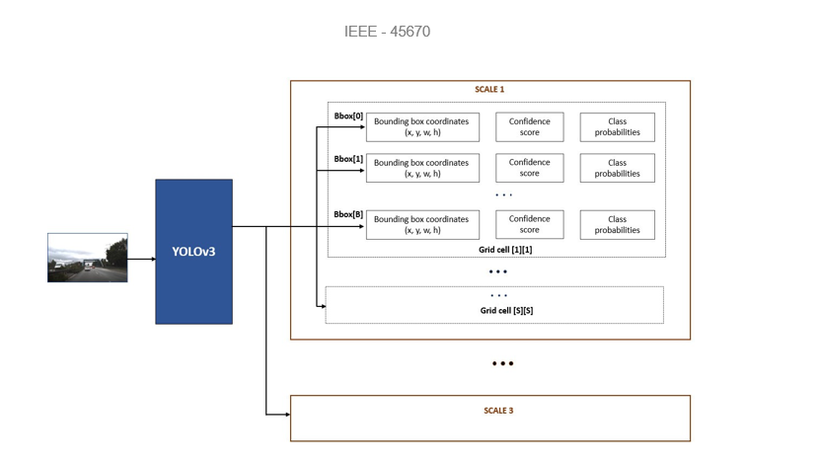
Detection Model Architecture (YOLOv3)

Slide 18
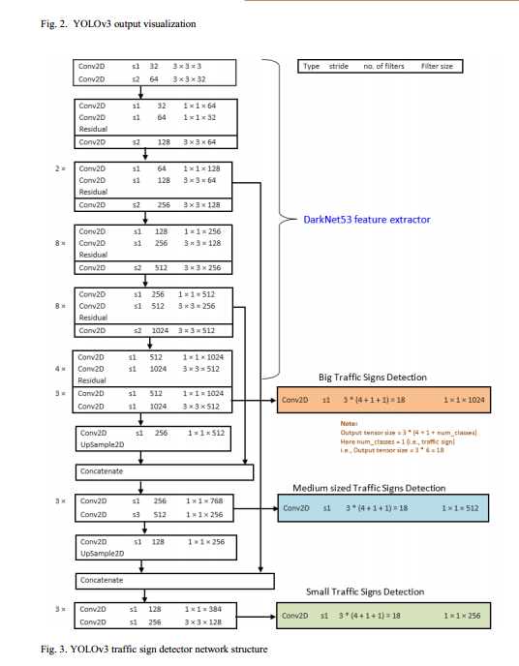
Detection Model Architecture (YOLOv3) Cont.

Slide 19
System Architecture 1 Approach:
-We Assume That Each Sign As A Class So That We Have (43) Class
-We Discovered That It Was Too Slow With Low Accuracy

Slide 20
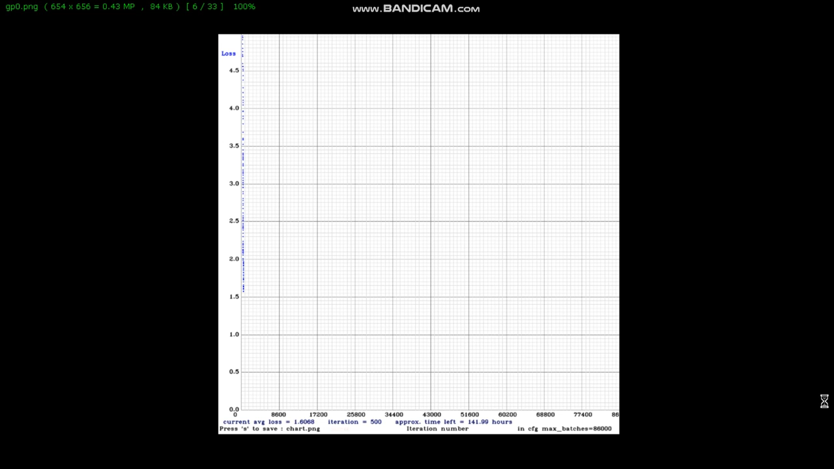
YOLOv3 training (classes)

Slide 21
Classification Model Architecture
-We Train (VGG16).
-This Model Reach a good accuracy only 97.5%

Slide 22
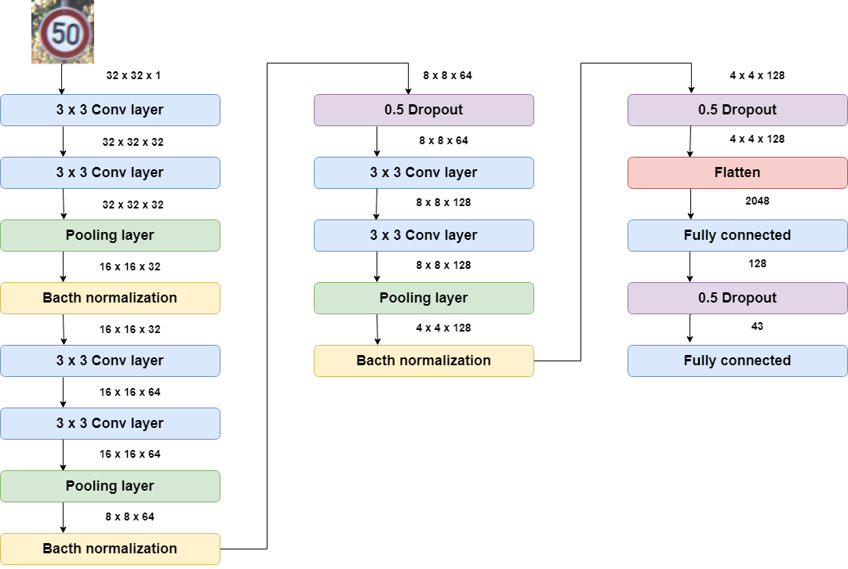
Classification Model Architecture(cont)

Slide 23
Problem With First Architecture
Connection Between Detection and Recognition Model Was Very Slow in Testing Phase
That is because of using the open cv that does not use the GPU as it reads a frame per two seconds.
Video Duration | Testing Time | Approx FPS
1 sec | 2 min | 0.46
133 sec | 57 min | 0.58

Slide 24
Agenda
Introduction
Survey
Dataset
System Architecture 1
System Architecture 2
Conclusions
Tools
Demo

Slide 25
System Architecture 2 Approach:
With The Same Architecture Of (Yolov3) We Use Another Approach
We Divide The (43) Classes into (4) Categories to train the YOLOv3
Categories are (Prohibitive , Mandatory , Danger , other).
This make the model reach higher accuracy (93%) and more faster in time (7.33 hours).

Slide 26
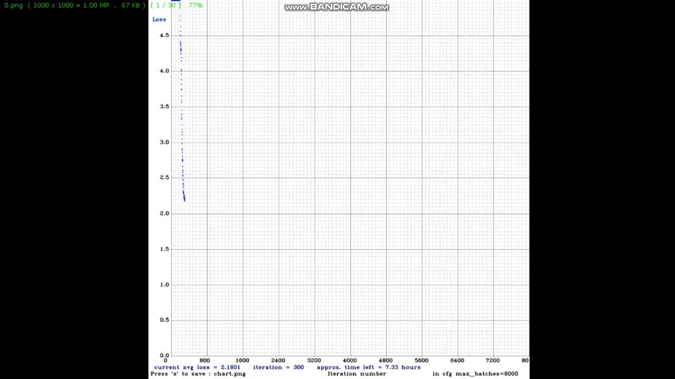
YOLOv3 training (categories)

Slide 27
Classification Model Architecture
We used the paper model instead of using the VGG16 with adding batch normalization layers and reach the accuracy of 99.2%

Slide 28
Classification Model Architecture
Layer | Type | Filter size | Filter/ stride | Output shape
1 | Conv + Batch normalization | 3 * 3 | 32, s1 | 48*48*32
2 | Conv + Batch normalization | 7 * 1 | 48, s1 | 48*48*48
3 | Conv + Batch normalization | 1 * 7 | 48, s1 | 48*48*48
4 | Max-pool | 2 * 2 | S2 | 24*24*48
5 | Dropout | 0.2 | - | 24*24*48
6-1 | Conv + Batch normalization | 3 * 1 | 64, s1 | 24*24*64
7-1 | Conv + Batch normalization | 1 * 3 | 64, s1 | 24*24*64
6-2 | Conv + Batch normalization | 1 * 7 | 64, s1 | 24*24*64

Slide 29
Classification Model Architecture(cont)
7-2 | Conv + Batch normalization | 7 * 1 | 64, s1 | 24*24*64
8 | Concatenate | - | - | 24*24*128
9 | Max-pool | 2 * 2 | S2 | 12*12*128
10 | Dropout | 0.2 | - | 12*12*128
11 | Conv | 3 * 3 | 128, s1 | 12*12*128
12 | Conv | 3 * 3 | 256, s1 | 12*12*256
13 | Max-pool | 2 * 2 | S2 | 6*6*256
14 | Dropout | 0.3 | - | 6*6*256
15 | Dense | 256 | - | 256
16 | Dropout | 0.4 | - | 256
17 | softmax | 43 | - | 43

Slide 30
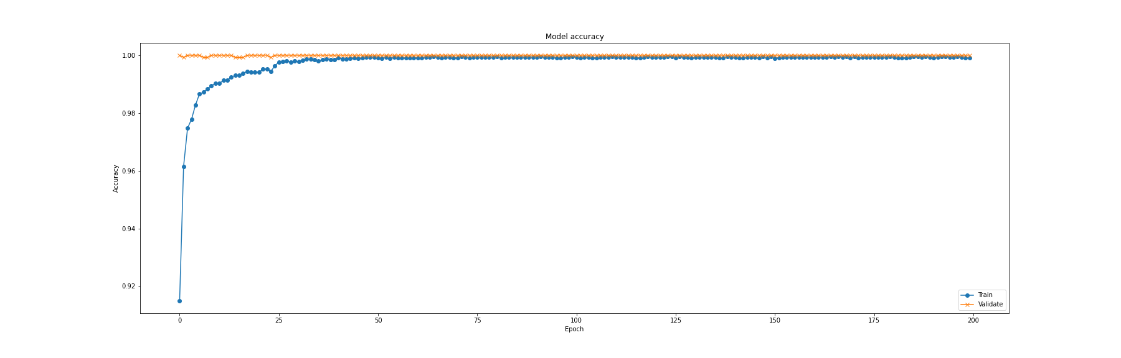
Model Accuracy
reach the accuracy of 99.2%

Slide 31
Solution Of Model 1 Problem
.
we use the GPU and this makes the connection and the testing faster by the double of the speed as It now reads a frame per second
Speed up 200%
Video Duration | Testing Time | Approx FPS
1 sec | 1 min | 0.83
133 sec | 33 min | 0.99

Slide 32
Agenda
Introduction
Survey
Dataset
System Architecture 1
System Architecture 2
Conclusions
Tools
Demo

Slide 33
Conclusions
Advantages
Disadvantages
The detector reach accuracy of 93% as it manipulate the classes as set of categories.
The detector can get traffic sign with small size.
Not real time system and read one frame per second.
The classifier could not reach the needed accuracy 99.5% only reach 99.2%
Need high resources to run and test.

Slide 34
Agenda
Introduction
Survey
Dataset
System Architecture 1
System Architecture 2
Conclusions
Tools
Demo

Slide 35



Tools
Google Colab.
Pycharm.
Python and libraries.

Slide 36
Agenda
Introduction
Survey
Dataset
System Architecture 1
System Architecture 2
Conclusions
Tools
Demo

Slide 37
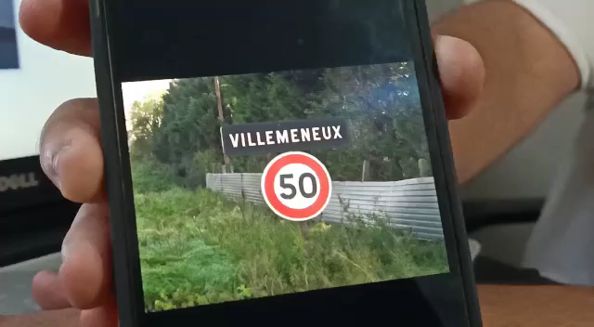

Slide 38
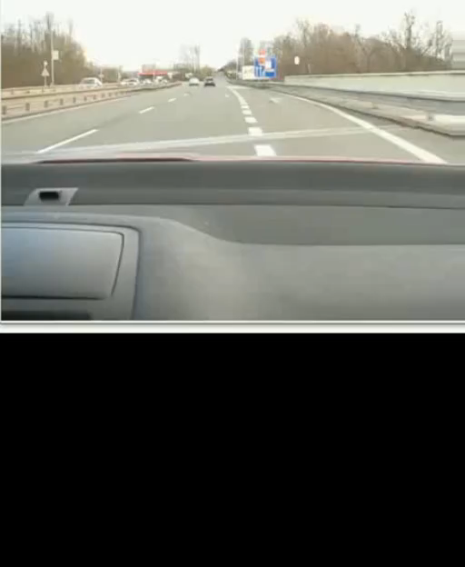
Place your screenshot here

Slide 39


Slide 40


